Slide 1

Advanced Object Oriented Programming
AUTOMATED BIRTHDAY WISH SYSTEM
By
B.Akshaya(2110030345)
U.Yesashwini(2110030412)
P.Subhatish(2110030426)
K.Dhana Sree(2110030444)
Under the guidance of
Mrs.Figlu Mohanty

Slide 2
PROBLEM STATEMENT AND DOMAIN
People sometimes forget to wish their friends, and family on their birthdays.
It is also difficult to remember every birthday.
So, we are developing an application that will help you never forget the birthday of your friends or family
We include reminders and also messages to be sent prior itself and send messages on your behalf via SMS.
It comes under Software Domain.

Slide 3
EXISTING SOLUTIONS
Facebook
Telegram
Calender

Slide 4
HOW OUR PROJECT WORKS
Firstly, the user needs to log in to the website with an Id and password.
Then comes the Homepage from which they have to select events like add, update, delete or view the birthday details.
They can make changes and also set reminders in case they forgot to add message.
We can schedule the message thereby by entering details like time, date, month, and your message to them.

Slide 5
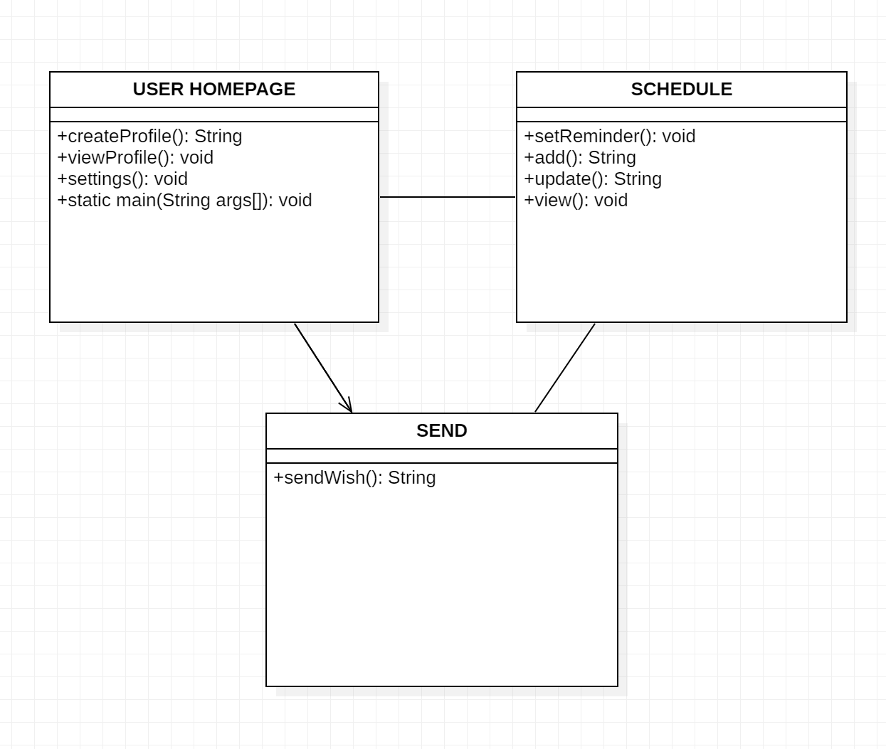
CLASS DIAGRAM

Slide 6
TOOLS REQUIRED
GUI INTERFACE
Front-end designing
STAR UML
For Class diagrams to summarize details of a system and the users within that system.
ECLIPSE IDE
Write Code for application

Slide 7
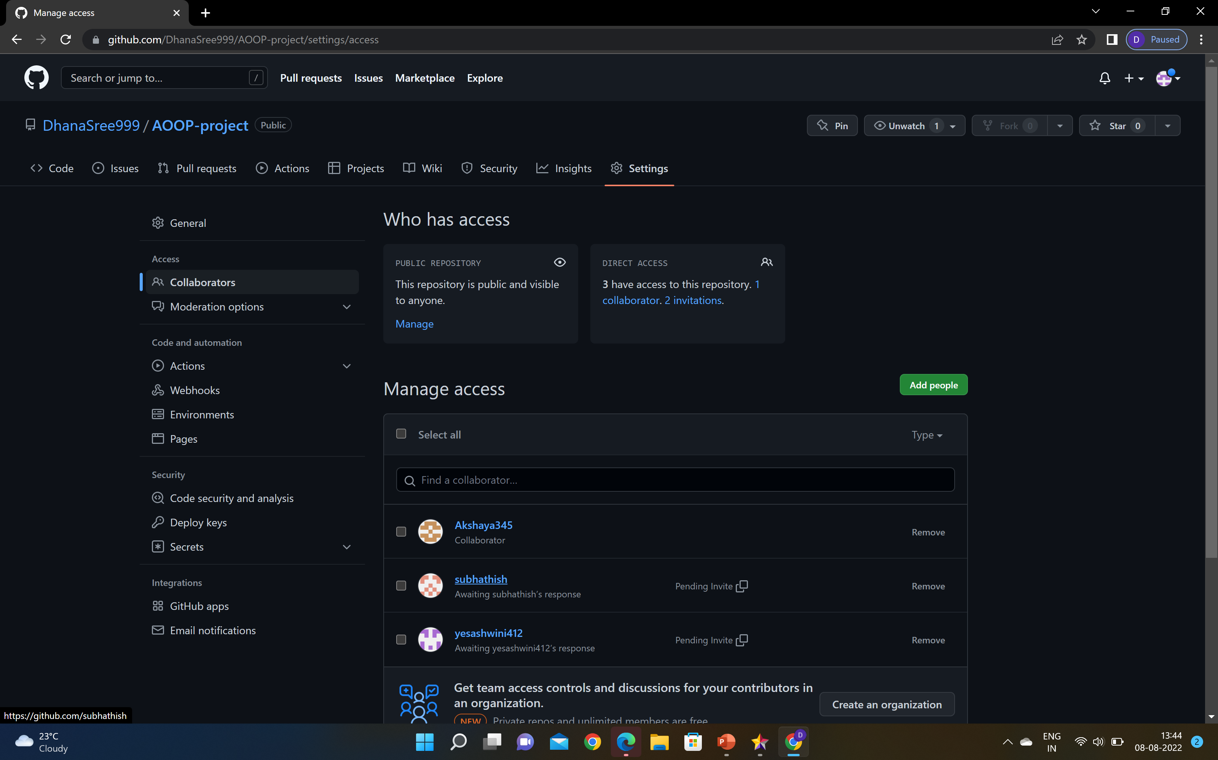
GITHUB SETUP
https://github.com/DhanaSree999/AOOP-project

Slide 8
GITHUB LINKS
https://github.com/DhanaSree999/AOOP-project
https://github.com/Akshaya345/AOOP
https://github.com/subhathish
https://github.com/yesashwini412

Slide 9
DIVISION OF WORK AMONG THE GROUP MEMBERS
S.NO | ROLL NO | NAME | DIVISION OF WORK
1 | 2110030345 | B.AKSHAYA | Communication, Software documentation
2 | 2110030412 | U.YESASHWINI | planning, testing
3 | 2110030426 | P.SUBHATHISH | Modelling, review
4 | 2110030444 | K.DHANA SREE | Development, maintenance

Slide 10


